Slide 1
Bridging cognitive and psychometric Models of Cognitive Abilities
An Investigation Based on Process Overlap Theory
Han Hao
Postdoctoral Researcher
Caliber Lab
New Mexico State University
05/08/2024 @ Tarleton State University

Slide 2



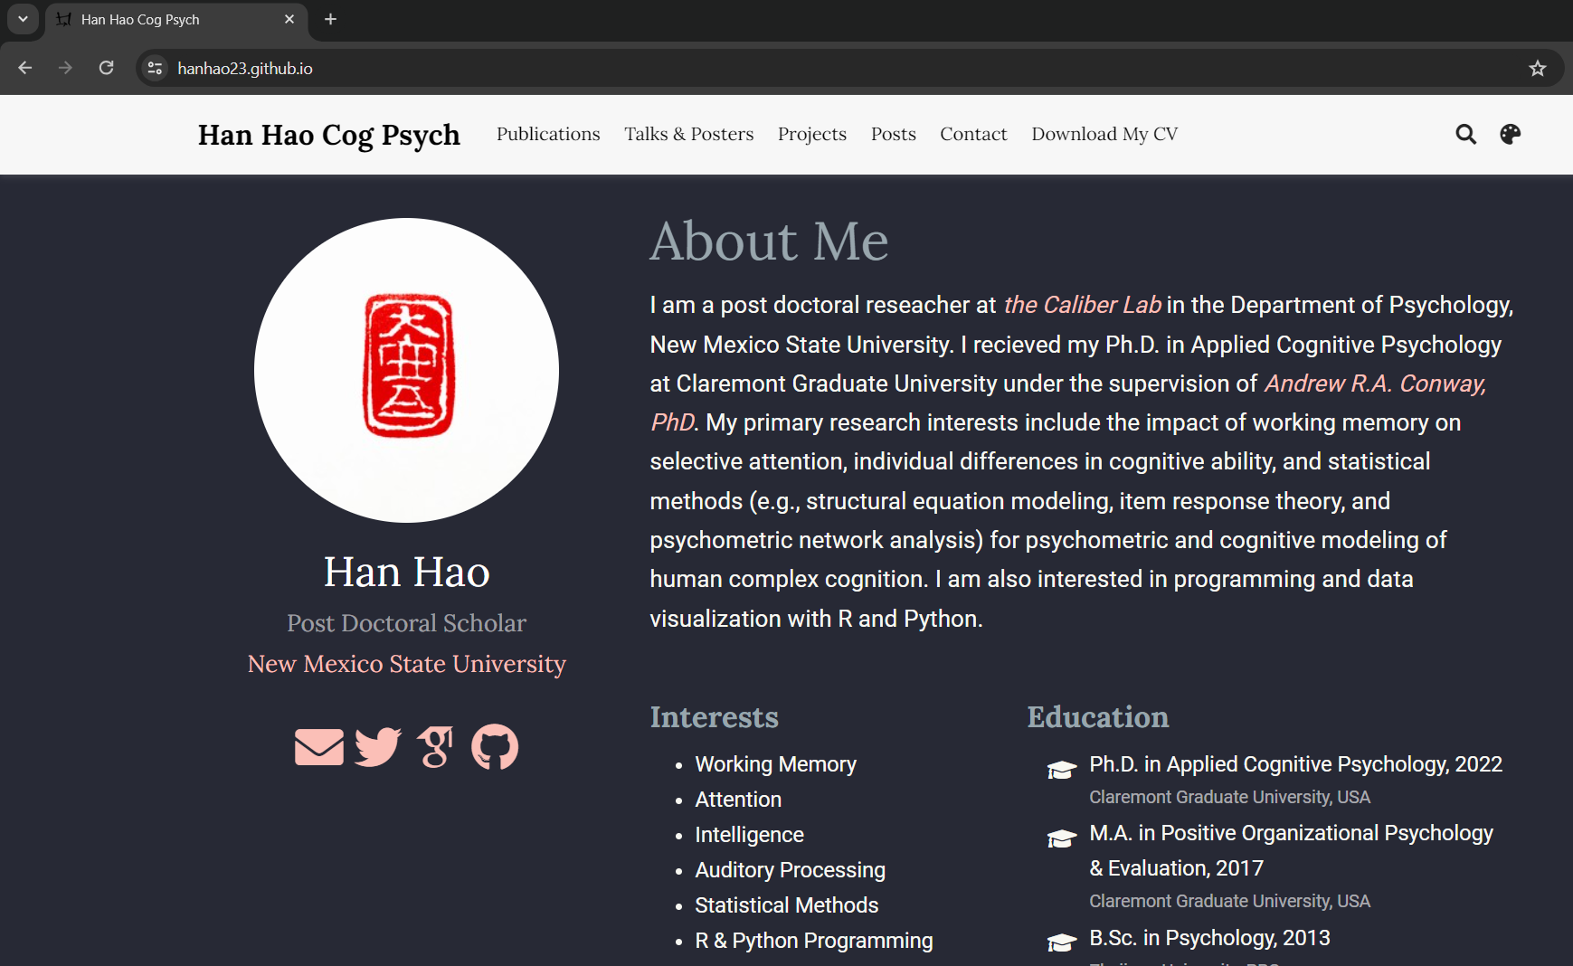
Introducing Myself
Postdoctoral Researcher @ New Mexico State University
Research interests:
Attention & Working Memory
Individual Differences in Higher-Order Cognitive Abilities
Statistical and Psychometrical Methods
https://hanhao23.github.io
Notes:
I am currently a postdoc at NMSU, before I came to mid-west I had my PHD at CGU. My research is generally focused on attention and working memory, individual diff in higher-order cognitive abilities, and I also do a little stats and psychometrics. If you want to know me more, here is my website. You can find my CV, projects, manuscripts and preprint, OSF pages, my stats tutorials or R code, everything. As you can see from the title of my talk and my research interests, we will be talking about quantitative research on cognitive abilities today.

Slide 3


Ability
How do we understand an ability?
“Able”, “Can”, “Potential”
“I have the ability to drive.”
Drive test!
Notes:
Now when we talk about the term “ability” and when we try to understand some “ability”, what do we mean by that? Whatever we refer to as an “ability”, there is always an indication of being…For example, my friend told me that she can give a ride to me to the airport because she have the ability to drive? How do I know if she has the ability to drive? Because she recently passed the drive test and got her license, and the drive test was designed to reflect one’s ability to drive safe and efficiently on road based on traffic rules

Slide 4

Ability
Ability
Test/Measure
Criteria/Differences
Notes:
So when try to have an understanding of an ability, we always need to rely on some test/measures that are based on certain criteria/standards, or if it is not a yes/no ability, at least some measures that can show differences.

Slide 5

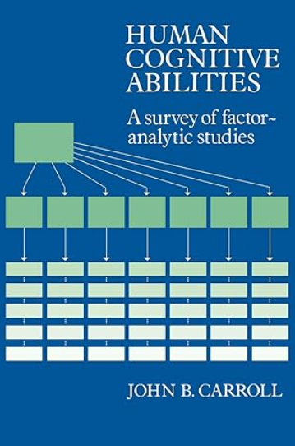

Cognitive Abilities
Cognitive ability
Cognitive task
Cognitive process
Notes:
This is also the case for cognitive abilities. Here I highly recommend Carroll’s classic book on human cognitive abilities, where he refer to
Cognitive ability: any ability that concerns some class of cognitive tasks
Cognitive task: any task in which correct or appropriate mental processing of information is critical to successful performance
Different from driving ability, for cognitive abilities we are not only interested in whether we have some abilities or not, we are also curious about what and why those cognitive abilities are showing certain patterns. In other words, we are also interested in understanding the mechanisms of cognitive processes, which are the mental action by means of which something is operated on to produce response.

Slide 6


Theories of Cog Abilities
Various definitions and theories to identify important cognitive abilities and to explain the patterns and variations of human cognitive behaviors (e.g., positive manifold, general intelligence)
Psychometric theories Cognitive theories
Notes:
Through over 100 years, there are numerous definitions and theories of human cognitive abilities, till this day, none of them is universally accepted.
Although there is a lack of agreement on the definition/theory, there are several robust findings in the field.
For example, we have consistently observed Positive manifold, which refers to the phenomenon that performance on different tests of mental abilities tend to be positively correlated regardless of test population or test battery.
Most of the cognitive ability theories were developed around these robust findings and the traditional theories could be roughly categorized into two branches.

Slide 7

Psychometric theories
Investigate correlational relationships and individual differences in performance of (cognitive) tests to understand the “map of mind” (Sternberg, 2012, p.19)
Correlational data, latent variable analyses
Stem from the investigation on (general) intelligence
Notes:
The psychometric theories investigate correlational relationships and individual differences in cognitive test performances and try to draw a map of mind. These theories usually investigate correlational data of different cognitive ability tests using latent variable models. The psychometric approaches stem from the investigation on human intelligence by Spearman.

Slide 8
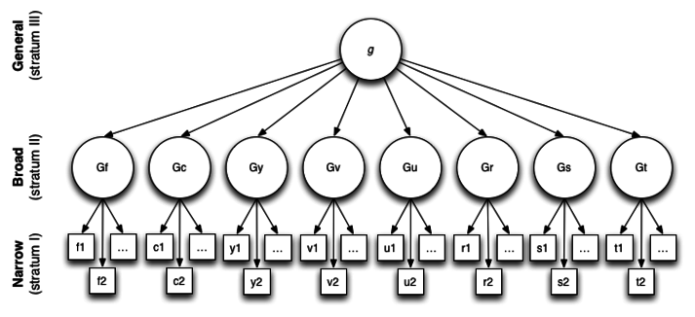
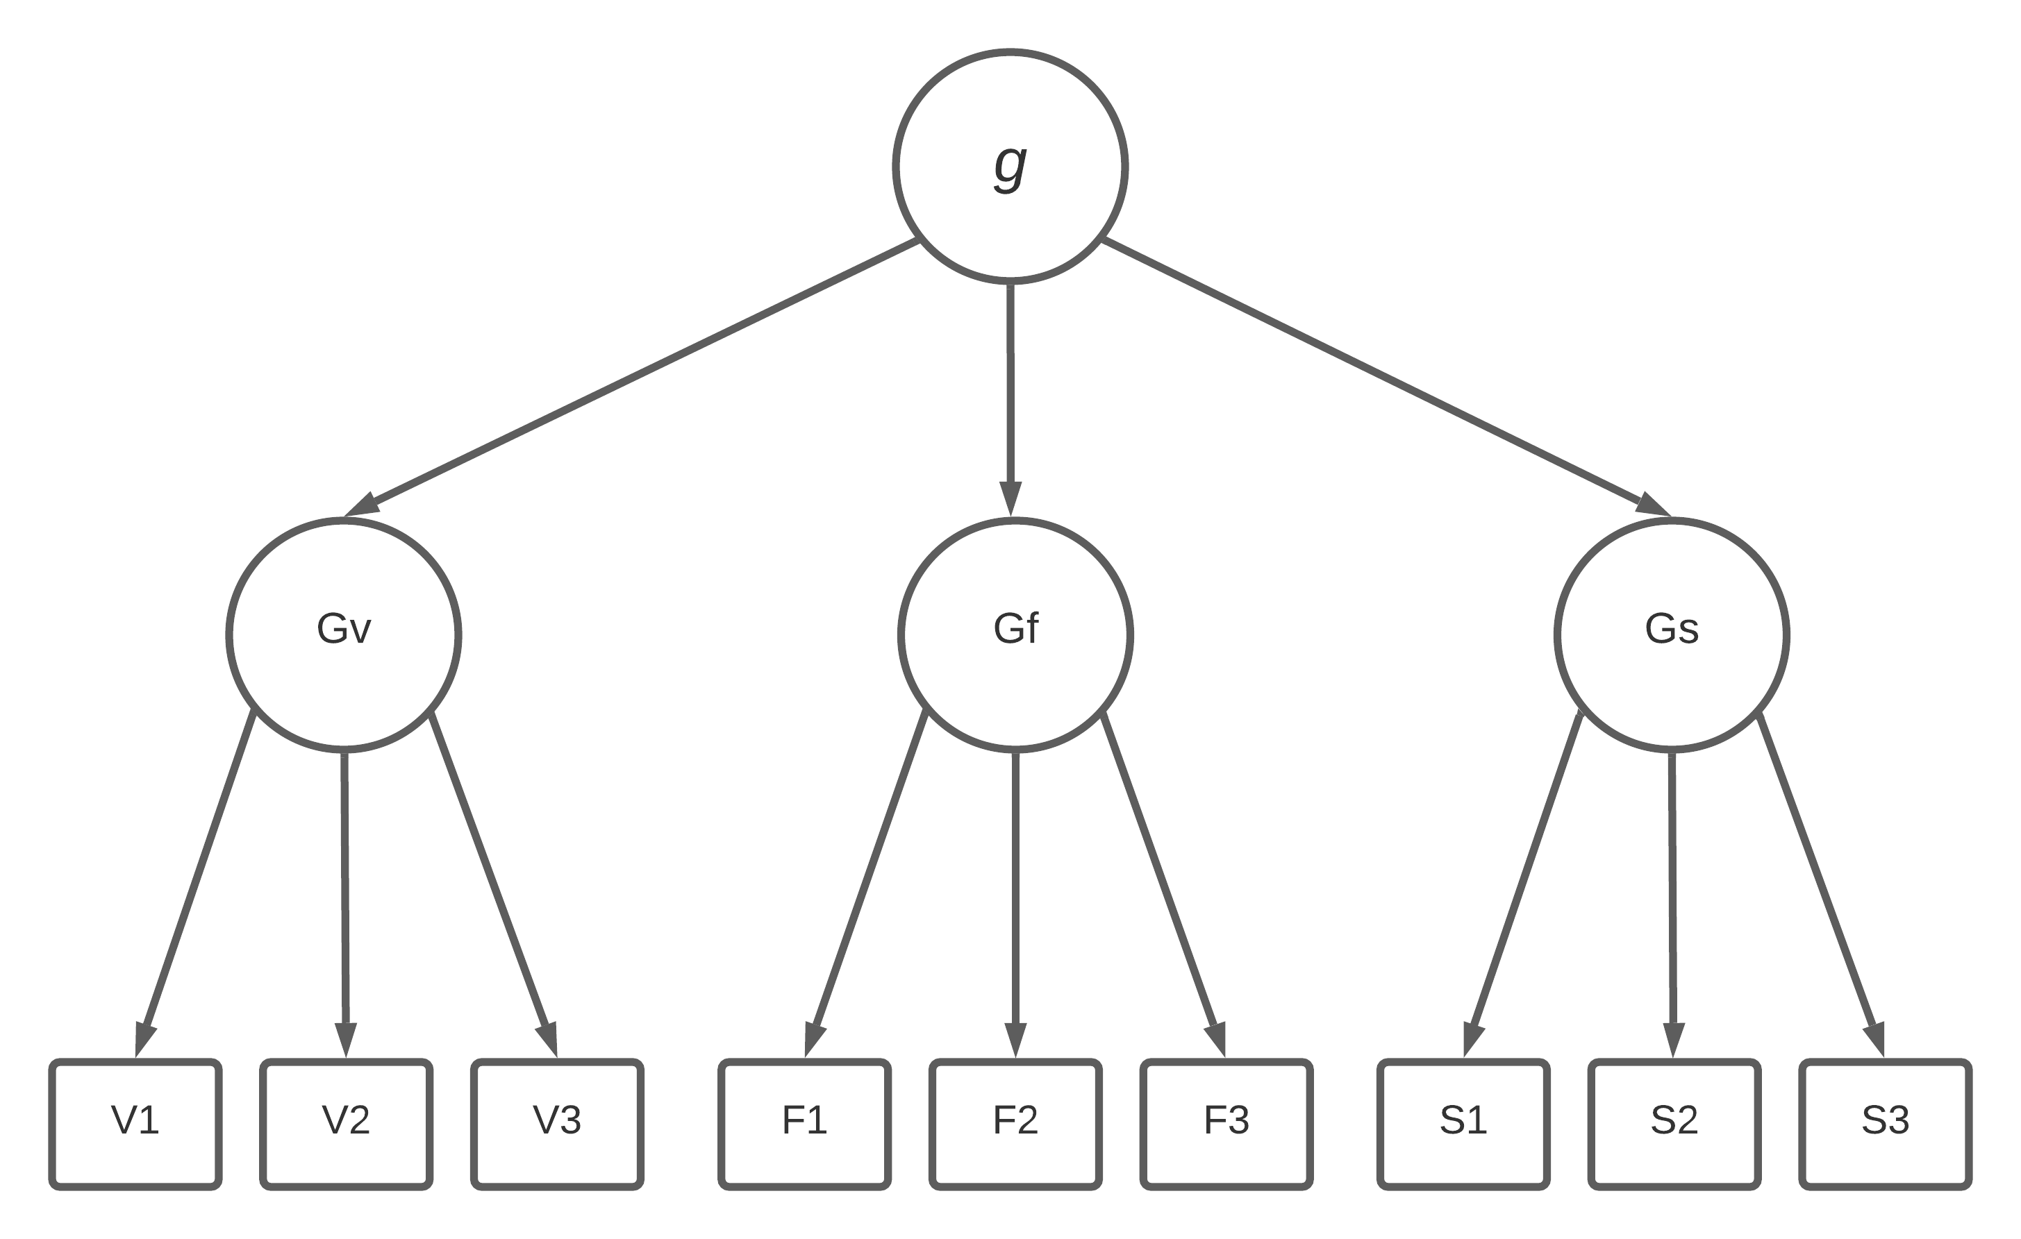
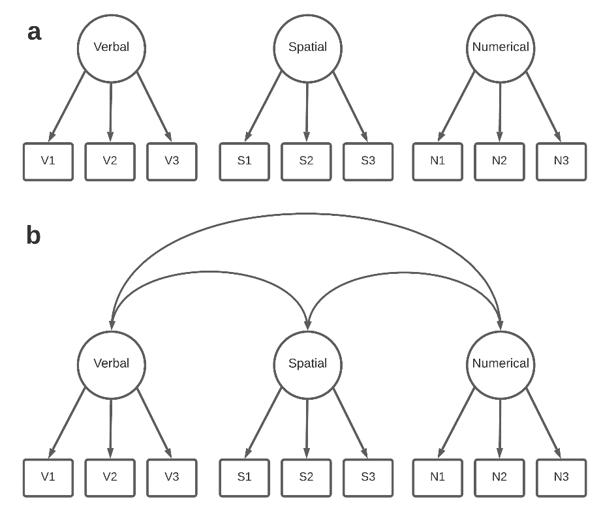
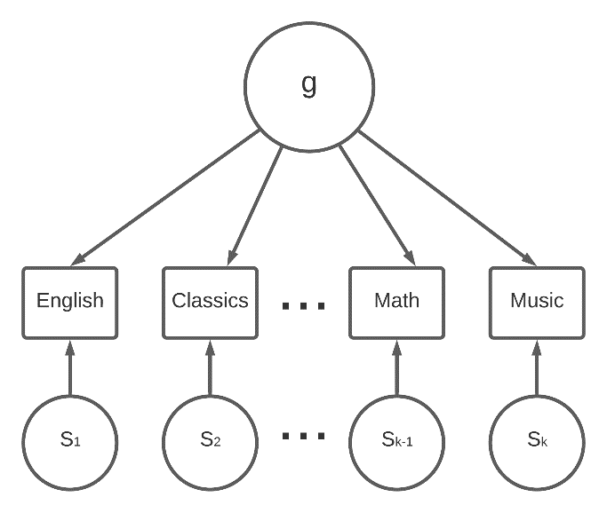
Intelligence Research
Spearman’s theory of general Intelligence
One-factor model of Intelligence
Thurstone’s Primary Mental Abilities
Multi-factor models of Intelligence
The Cattell-Horn-Carroll Theory
Carroll’s Three-Stratum Theory
Cattell-Horn’s Gf-Gc Theory
Notes:
It started with Spearman’s general intelligence theory, in which Spearman proposed factor analysis to investigate subjects’ performance on a range of intellectual tests and interpret the positive manifold of those test performance using a general factor. And he called the factor “the general intelligence” or g. Later on Thurstone and other researchers proposed multiple factor structures that explain the correlations in better ways. And building upon these early models, the most recent and probably the most influential psychometric model is the CHC hierarchical model, which can be regarded as a higher-order factor model. The CHC theory identified 70 to 80 narrow abilities, they are organized by 8 to 16 broad abilities as the subfactors, and there is a higher-order general intelligence factor hovering over the broad abilities. Overall, the psychometric theories rely on psychometric models from correlational data on representative selections of cognitive tests to illustrate a quantified structure of human cognitive abilities.

Slide 9

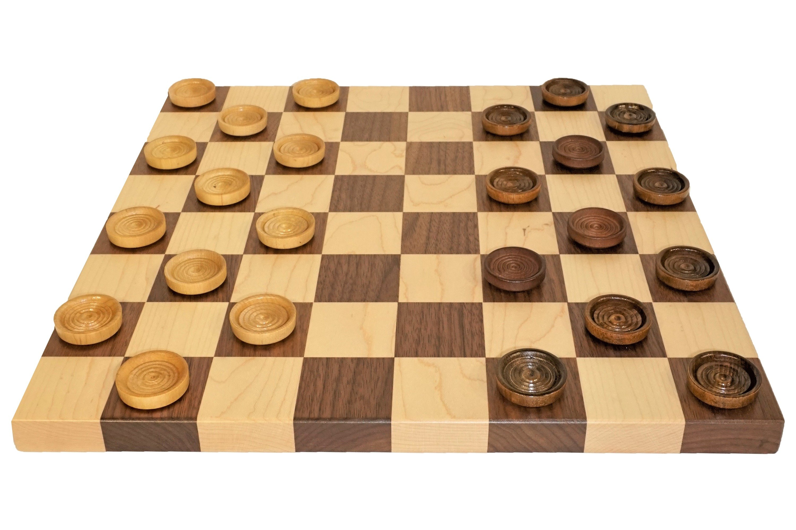
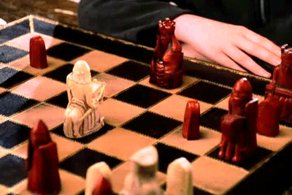
Cognitive theories
Investigate the specific roles of important cognitive processes in cognitive activities as basic components in information processing
Notes:
On the other hand, cognitive theories investigate the specific roles of mental processes in cognitive activities and regard cog processes as basic components in information processing. Cognitive researchers try to find the most influential cognitive process and try to identify how these important process work to influence cognitive activities. One of the analogies I’d like to use, which is not 100% accurate but relatively intuitive, is that the psychometric perspective is more like playing checker, and the cognitive perspective is more like playing chess.

Slide 10
Cognitive theories
Investigate the specific roles of important cognitive processes in cognitive activities as basic components in information processing
Experimental & correlational approaches
Working Memory (WM)
Executive Functions (EF)
Notes:
Cognitive theories rely on both experimental and correlational approaches. In the experimental approaches, we have different conditions in a task and by looking at performance differences across conditions we can have an estimate of certain cognitive process; while in correlational approaches we have multiple measures that are designed to reflect the individual differences on the same cognitive process so we can have an error-free estimate of the process. Over the years there have been multiple cognitive processes/mechanisms that were found to be essential across a wide range of cog behaviors, such as WM and EF.

Slide 11
Working Memory
Cowan, 2005; Oberauer et al., 2018
A system that maintain temporary availability to a limited amount of information for ongoing information processing (Cowan, 2017)
An attentional bottleneck to higher-order cognitive abilities
r = .70 to .90 for WM & gF (Kane, Hambrick, & Conway, 2005)
WM is associated with a variety of real-world cognitive behaviors such as metacognition and learning
Notes:
In a brief way, WM can be defined as a system of cognitive processes that maintain access to a limited amount of temporary information to be available for ongoing information processing. Researchers have found that the domain-general mechanism of WM serves as an attentional bottleneck to higher-order cognitive abilities. The correlation between WM and fluid reasoning are usually as high as .70 to .90, which means they share over 50% of variances. And of course, we have also found that WM associating with a variety of real-world cognitive behaviors such as learning and metacognition.

Slide 12
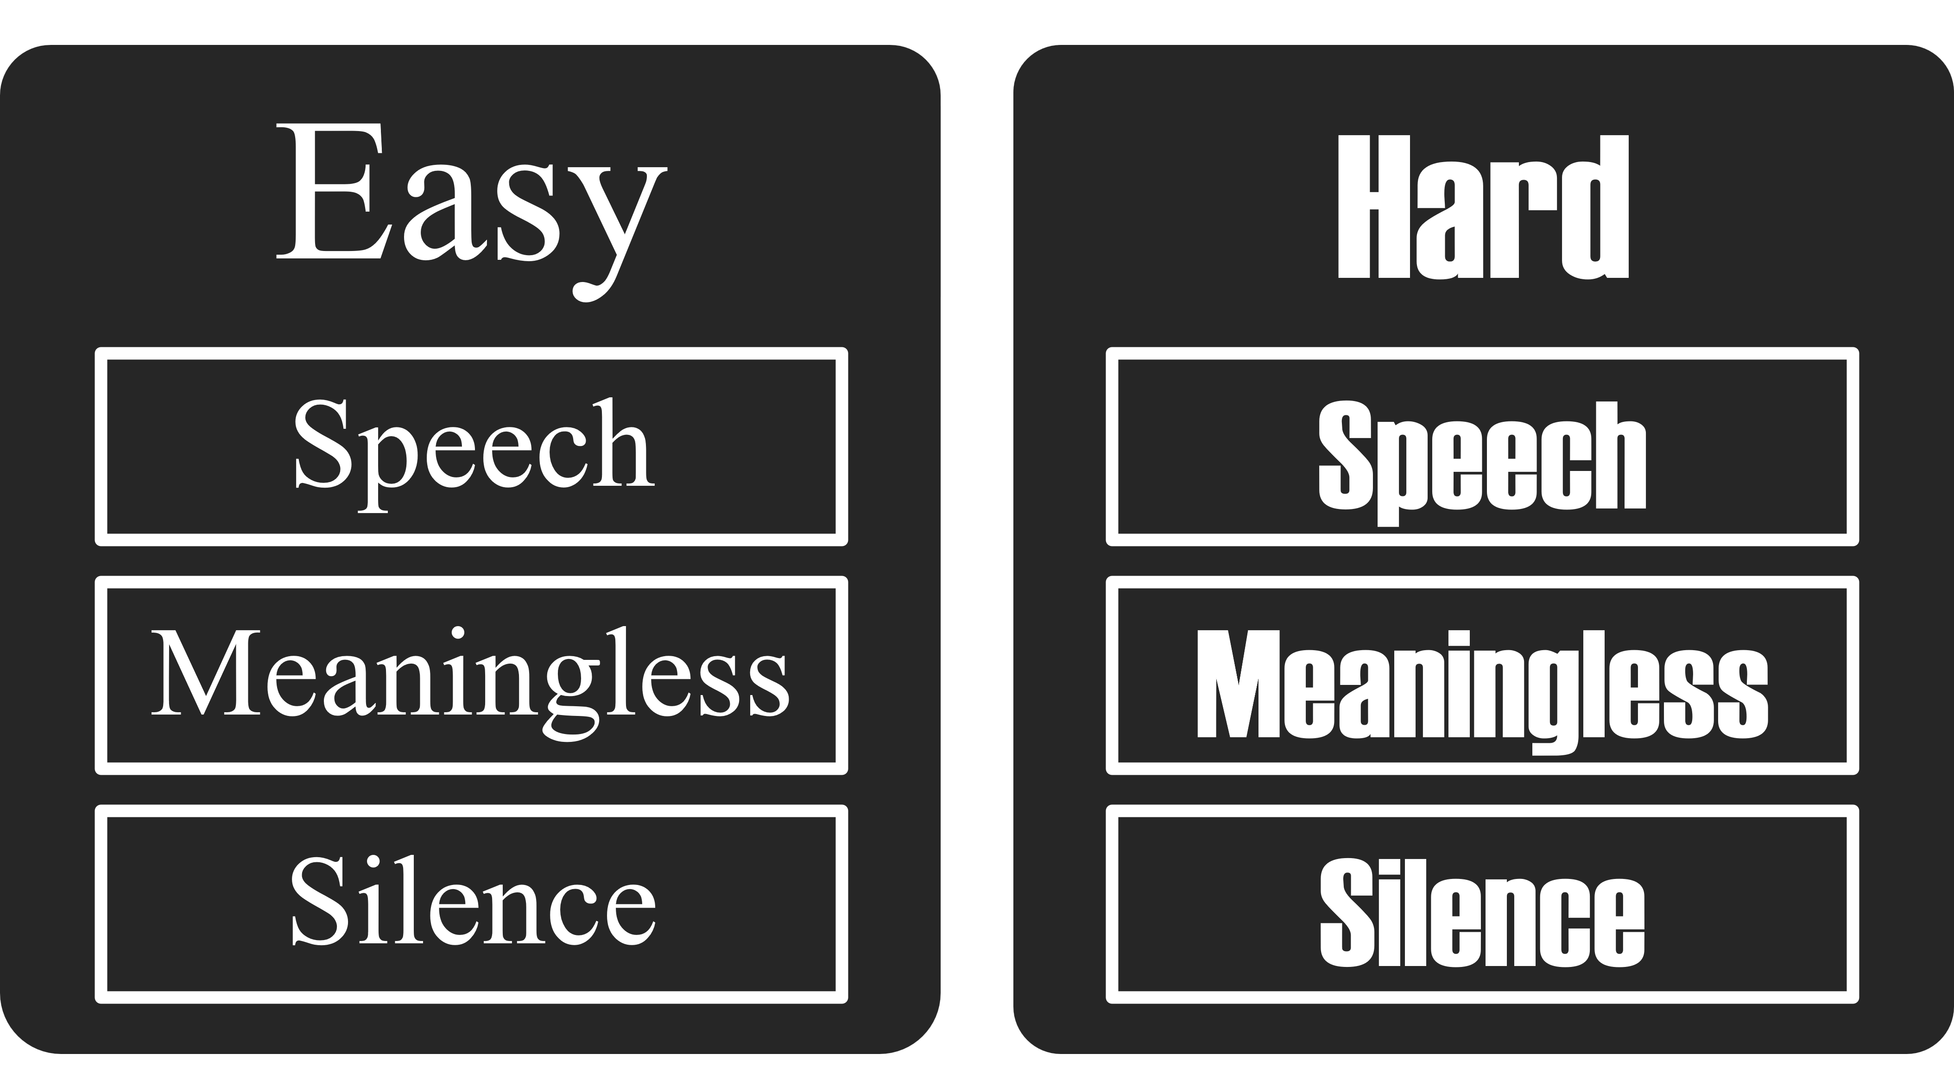
Working Memory
Hao & Conway (2022)
How background noise disrupts auditory selective attention and impairs performance on reading comprehension considering the impact of individual differences in WMC
N = 126, 2 X 3 Mixed factorial
Perceptual disfluency (Between: Easy vs. Hard)
Background noise(Within: Silence, Meaningless, Speech)
Working memory capacity (Reading & Rotation Span)
Notes:
For example, in one of my previous studies, we investigated the influence of WM on reading comprehension under auditory distractions and perceptual disfluency. Perceptual disfluency is, in some literatures, considered as a manipulation of metacognition on task difficulty, and background noise is a common auditory distraction in real life that could influence one’s attention and cognition. It was a 2*3 mix factorial design. Subjects are randomly assigned to two disfluency groups, so that half of them took the reading comprehension tests in a hard-to-read font, which is considered to be a disfluency manipulation that increases one’s metacognition of difficulty and perform the tasks with higher motivation. The other half took the tests in a easy-to-read font as a control group for the disfluency manipulation. Both groups conducted three reading comprehension tests under three different auditory distraction conditions. WMC of the subjects were also measured.

Slide 13
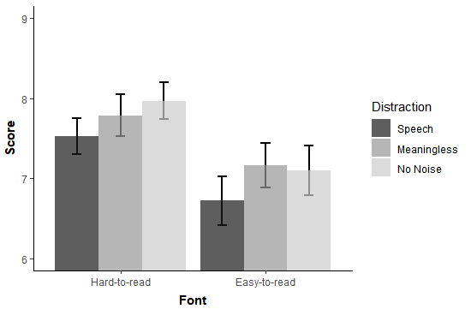
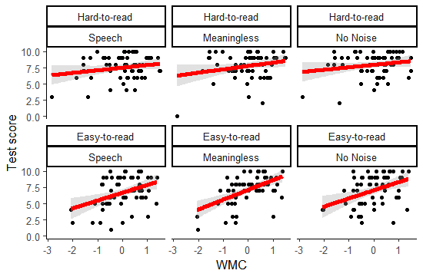
Working Memory
Experimental: Hao & Conway (2022)
Notes:
Without considering individual differences in WMC, we found that, perceptual disfluency has a positive effect on reading comprehension performance regardless of distraction condition.
but this effect was moderated by individual’s WMC; in other words, WMC and disfluency has a moderation effect on reading comprehension performance. WMC was less predictive of reading comprehension when the texts were disfluent. Here we can actually see the role of WM on both metacognition and learning. Which is align with what the cognitive theories of WM indicated

Slide 14
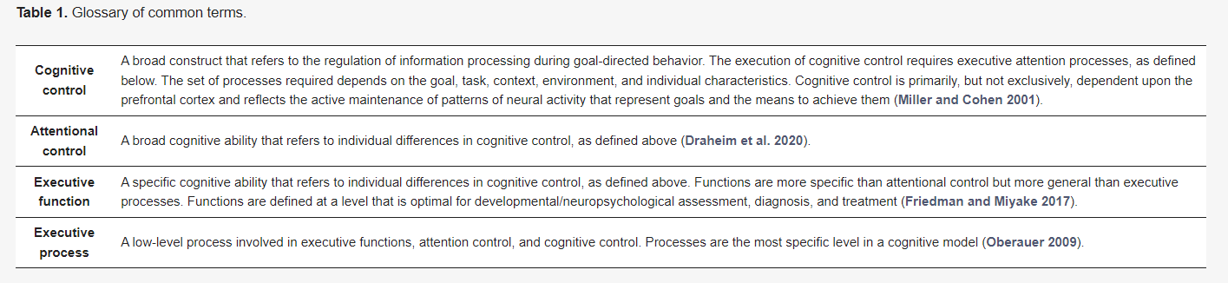
Executive functions
Executive functions (Diamond, 2013; Frischkorn et al., 2019)
correlated with intelligence, but evidence is mixed
Conway, Kovacs, Hao, Rosales, & Snijder, 2021
Notes:
Cognitive theorists have already identified several essential cognitive processes of intelligence. Three of the most frequently discussed cognitive processes/mechanisms are processing speed, working memory, and executive functions. And it is commonly agreed that these three mechanisms are all important predictors of individual differences in intelligence. Unfortunately, there is still limited consensus on their exact roles and relationships to intelligence and between each other.

Slide 15

Problems
Psychometric theories: “The common-cause premise problem”
Common variance = latent factor ≠ a cognitive process/mechanism
Cognitive theories: “The measurement problem”
Hard to associate the empirical differences in cognitive tasks to specific cognitive processes as most cognitive tasks are complex in nature
Notes:
Although the two types of theories are both approaching the understanding of human cognitive abilities, these conventional theories have their problems.
Psychometric theorists had been focusing on understanding g as a general psychological ability and have been largely relying on the latent factor approach. In latent factor models, the common variances among measures are assumed to be caused by a general source and represented as the latent factor. However, a latent factor does not necessarily translate to a specific cognitive process or mechanism. So psychometric theories actually cannot specify the exact cognitive processes and mechanisms that prompt the correlational structures of cognitive abilities.
Cognitive theories have a problem of measurement because in reality most cognitive tasks are complex in nature and it is hard to associate the empirical differences in different task conditions to specific cognitive process. In other words, no cognitive task is process pure. Also, cognitive theories do not perform well in describing how different cognitive processes (especially across different theories) cooperate with each other and contribute to intelligence as a system.

Slide 16
Problems
The IRT measurement of WM: Navarro, Hao, Rosales, & Conway (2023)
How verbal and spatial complex span tasks assess domain-general WM at the item-level
Reveals influences of domain-general WM and domain-specific storage for different task types
Notes:
examining domain-general WM by using only one task might elicit skewed scores based on task domain
visuospatial complex span tasks should be prioritized as a measure of WMC if resources are limited
Domain-general vs Domain-specific

Slide 17
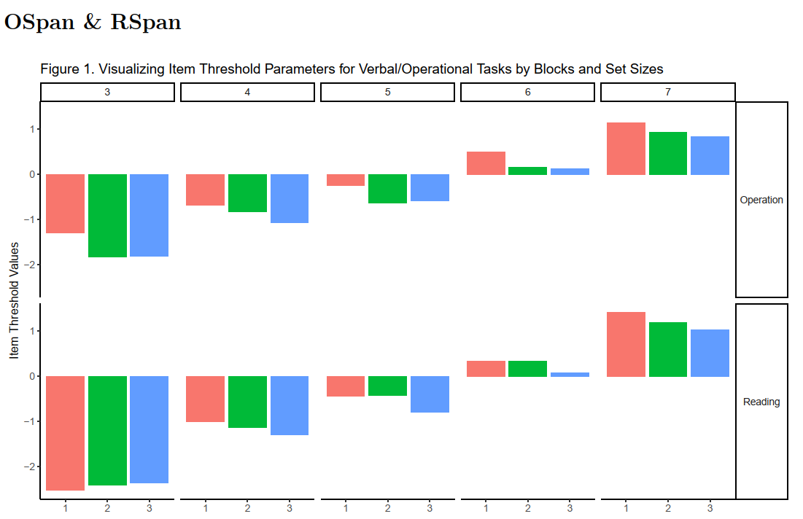
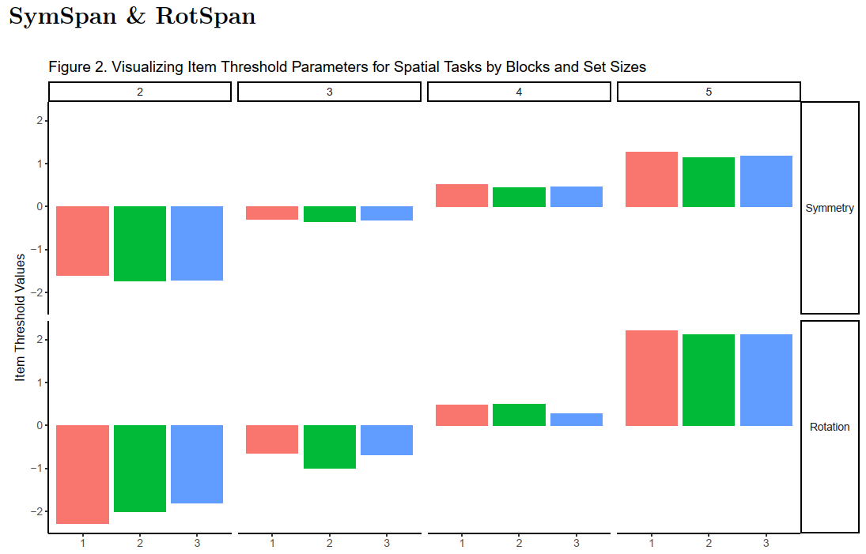
Problems
The IRT measurement of WM: Navarro, Hao, Rosales, & Conway (2023)
How verbal and spatial complex span tasks assess domain-general WM at the item-level
Reveals influences of domain-general WM and domain-specific storage for different task types
Notes:
examining domain-general WM by using only one task might elicit skewed scores based on task domain
visuospatial complex span tasks should be prioritized as a measure of WMC if resources are limited
Domain-general vs Domain-specific

Slide 18



Process Overlap Theory
Bridge the gap between psychometric theories and cognitive theories
Notes:
Therefore, contemporary intelligence theories have been developed to provide a more unified perspective by combining both types of approaches, allowing the correlational associations among measures of cognitive abilities to be explained by information-processing mechanisms. Specifically, Kovacs and Conway in 2016, proposed the process overlap theory. It is a theoretical framework that tries to bridge the gap between psychometrics and cognitive psychology.

Slide 19

Process Overlap Theory
Kovacs & Conway (2016; 2019)
Attempts to explain inter-individual differences in intelligence in terms of intra-individual psychological processes
Proposes an alternative cognitive foundation of positive manifold of intelligence (formative g)
Notes:
Process overlap theory, or POT, attempts to explain inter-individual differences in intelligence in terms of intraindividual psychological processes. POT proposes an alternative cognitive foundation of positive manifold by regarding the positive manifold as the consequence of the overlapping activation of the cognitive processes that are involved in the tests, instead of a general source of common variance that is psychometrically unobservable. In other word, POT recognize g only as a formative construct, or statistical artifact, but not a reflective, psychological construct.

Slide 20
Process Overlap Theory
A unified theory of intelligence based on the sampling theories (Thomson, 1916)
Processes
 | 1 | 2 | 3 | 4 | 5 | 6 | 7 | 8 | 9 | 10 | 11 | 12 | 13 | 14 | 15 | 16 | 17
1 | + | + | + |  |  |  |  |  | + | +
2 |  | + | + | + |  |  |  |  |  | + | +
3 | + |  |  | + | + |  | + | + |  |  |  | +
4 | + | + |  | + | + | + |  |  |  |  |  | + | +
5 |  |  |  |  | + | + | + |  |  | + |  |  |  |  | + |  | +
6 |  |  |  |  |  | + | + | + | + |  |  |  |  |  | +
Notes:
This theory was inspired by the sampling models in the early 1900s. The sampling models argued that the correlations between test scores across different cognitive tests are caused by the overlap of processes taped by the tests. Here is a brief illustration. Consider we have several cognitive tests and a bunch of cognitive processes related to the tests. Each test evolves some of those processes, so there will be overlaps of processes between different tests, but not a single process is generally activated in every test. Furthermore, the strength of the correlation between two tests is dependent on the overlap between the sets of processes being activated in the two tests.

Slide 21
POT Sampling Mechanisms (POT-V)
Domain-general and domain-specific processes are sampled in an overlapping manner across a battery of tests
Executive attention processes (as domain-general processes) are sampled more often than domain-specific processes across different tasks
Executive attention processes are also sampled more often in fluid reasoning tasks than in domain-specific tasks
The sampled processes are compensatory within each domain and non-compensatory across domains
Notes:
Based on the sampling models, POT proposed a set of sampling mechanisms that are motivated by the research on cognitive psychology such as research on working memory. The central mechanism of POT can be verbally described in 4 statements.
Give takeaways/animation

Slide 22
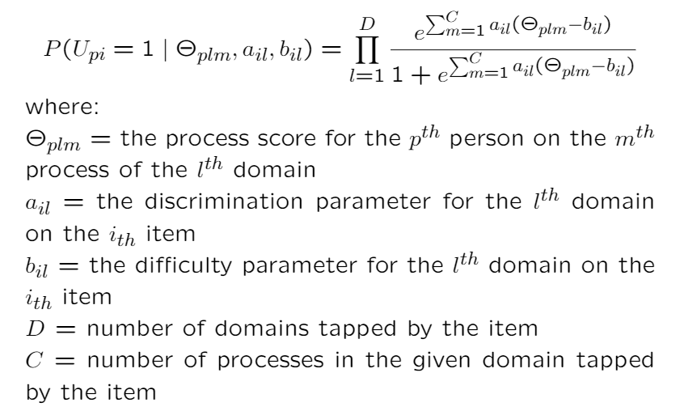
POT IRT Model (POT-I)
Notes:
This POT mechanism can also be translated into a computational expression using an IRT function here. I’m not going to dive into the details here but the IRT function translated the previous statements into this math equation of the probability of subject response for a specific cognitive test item.

Slide 23
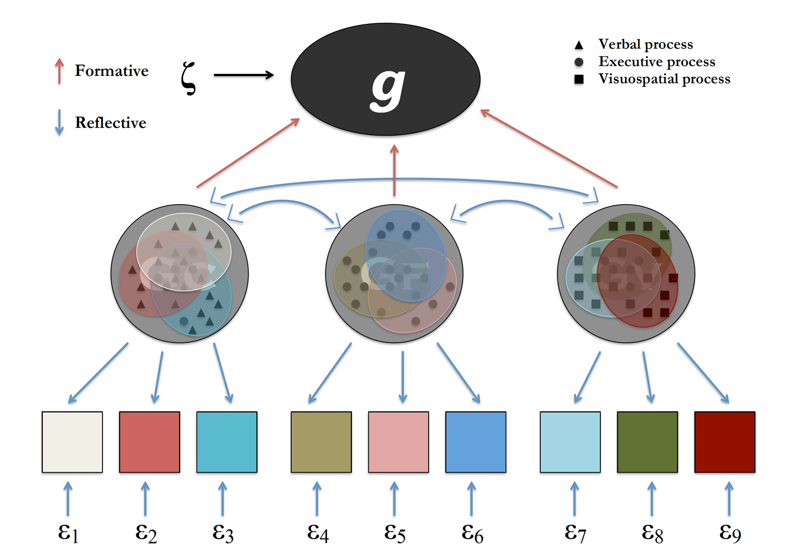
POT Structural Model (POT-S)
Kovacs & Conway (2016)
Notes:
While the IRT function leans on the cognitive side, POT can also be described as a structural model. But unlike the conventional latent factor models in most psychometric theories, POT regards g as a formative factor caused by the sampling mechanisms. That’s a brief introduction of the process overlap theory in 3 forms: the conceptual model, the IRT model, and the structural model, some of them are more conceptual and others are more computational

Slide 24
Simulating the Process Overlap Theory
A Unified Framework Bridging Psychometric and Cognitive Perspectives
Hao, Conway, Kovacs, & Snijder (2023)
Notes:
This is a simulation study. We focused on translating the theoretical and computational model of POT into simulated data based on statistical algorithms and fit those data to latent variable models that are comparable to real-world psychometric models

Slide 25
A Simulation Study of POT
The simulation translates the conceptual and IRT model of POT to sampling algorithms on simulated matrices and demonstrates:
A) “g” can emerge from the simulated test scores in the absence of a general cognitive ability
B) the broad ability factors can emerge by introducing a distinction between domain-general and domain-specific processes, and how they are sampled by different types of tests
Notes:
We want to demonstrate that: ….
The sampling algorithms represent subjects’ individual differences in all the cognitive processes that are relevant to designated cognitive tests.

Slide 26
Sim Procedures
Simulate a sample of 1000 subjects performing 9 tests
Fluid, Verbal, & Spatial
Each subject has a set of 60 cognitive processes
Apply 2 specific sampling algorithms to the simulated processes
The general sampling algorithm (GSM) vs The POT algorithm (POT)
200 simulations
Notes:
GSM
All 60 processes are sampled with equal probability (p = .10) across every task and item
For a specific item, about 60*0.10 = 6 processes are expected to be sampled
POT
For an item in Gf tests, domain-general (EF) processes are sampled with greater probability (p = .28) than domain-specific (Fluid Reasoning) processes (p = .12)
On average, 4 EF (15*0.28) + 2 Fluid (15*0.12) processes are expected to be sampled for an item
For an item in verbal/spatial tests, domain-general (EF) processes are sampled with smaller probability (p = .12) than domain-specific (Verbal/Spatial) processes (p = .28)
On average, 2 EF (15*0.28) + 4 specific (15*0.12) processes are expected to be sampled for an item

Slide 27
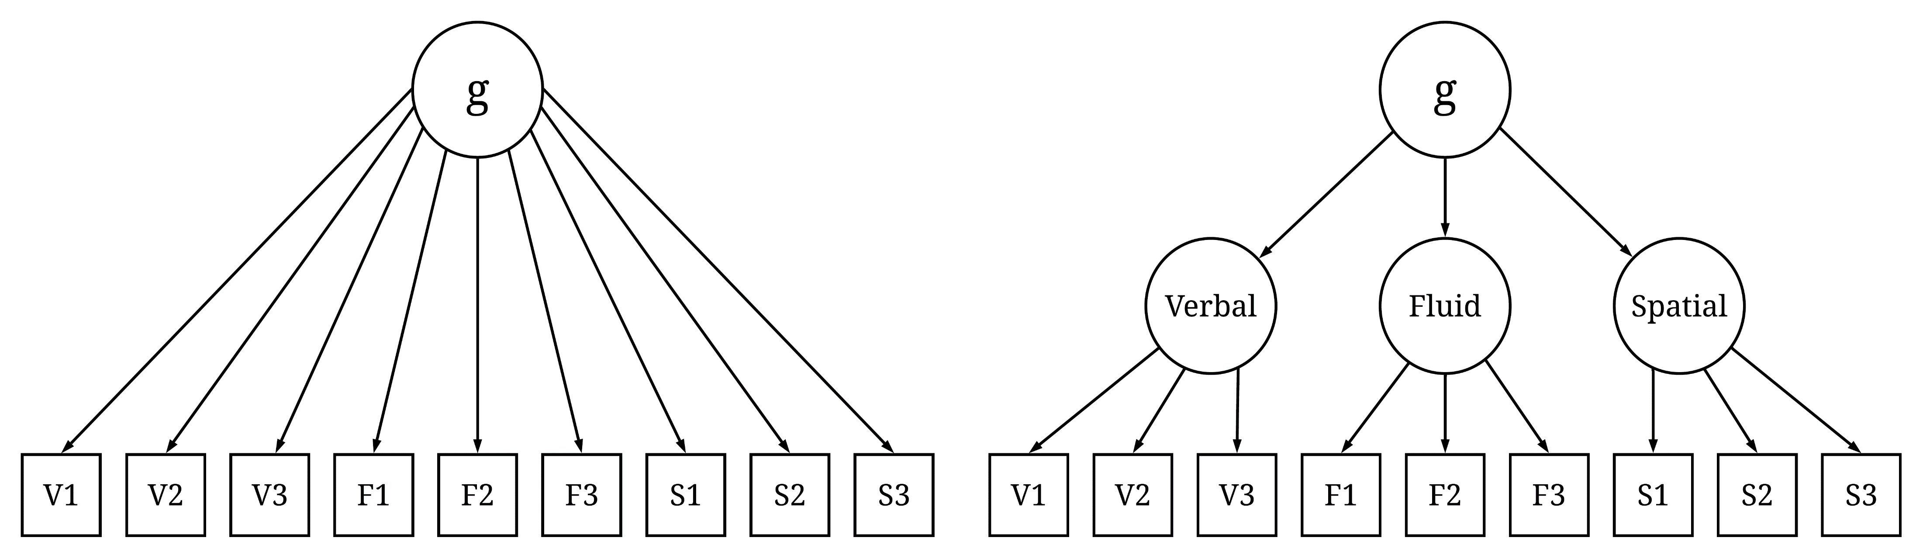
Sim Procedures
Fit psychometric models to simulated data
Notes:
We predict that for the GSM data the one-factor model would fit well, and the higher-order model would be an overfit.
For the POT data the one-factor model should convey poor fit while the higher-order model would be appropriate.

Slide 28
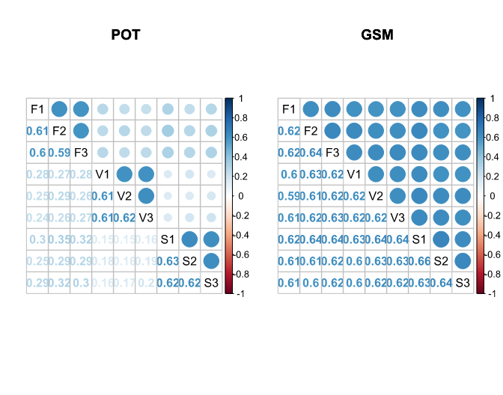
Correlation Matrix for GSM Algorithm
Correlation Matrix for POT Algorithm
Fluid
Verbal
Spatial
Iterations: 200
Notes:
We repeated the simulation procedure 200 times. Each of the 200 runs produced two correlation matrices that we can use for model fitting. Here I’m showing you the result of one run. So we actually had 200 pairs of matrices like this. We can see here, for the POT data, the correlations are already exhibiting small clusters of strong correlations while for the GSM data the correlations are all in the same magnitude. That’s exactly what we predicted based on the algorithm differences. And let me bring this up again that in neither algorithm, we relied on a common cognitive process to produce these correlations. They are all because of the sampling overlaps among the items and tests.

Slide 29
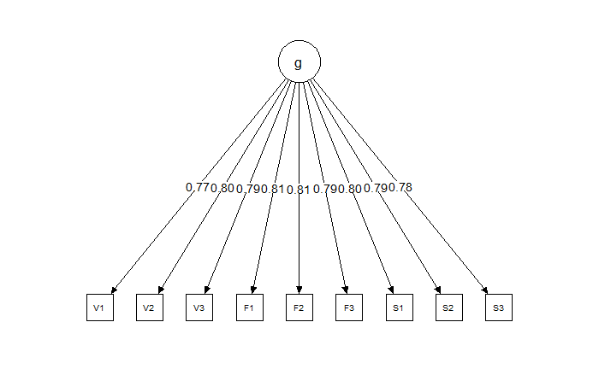
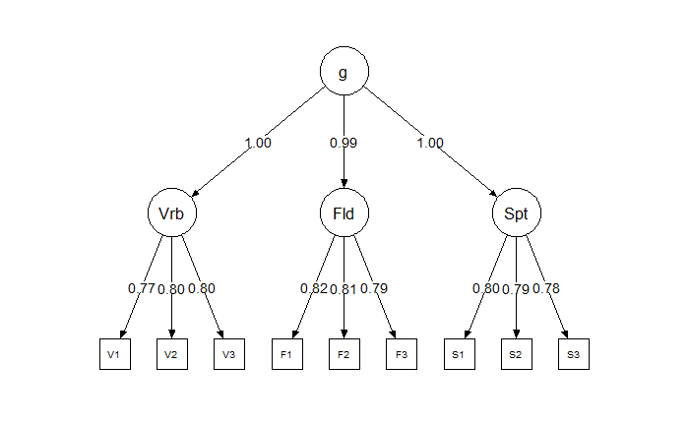
SIM Results (GSM Algorithm)
Notes:
This result was more obvious when we look at the models. Again, this are the model results and factor loadings from one run. For the GSM data the one-factor model fits well. All loadings are balanced here. And the higher-order model is apparently an overfit. The higher-order loadings are all almost 1.

Slide 30
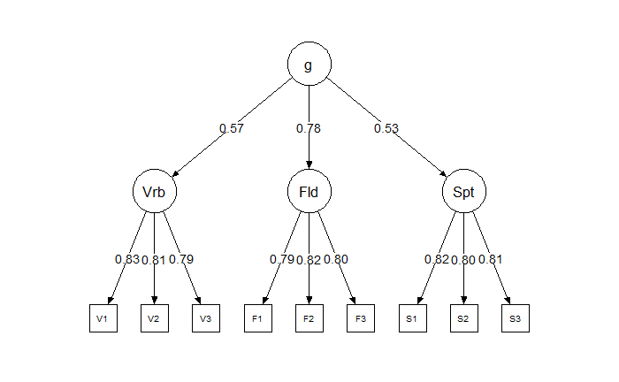
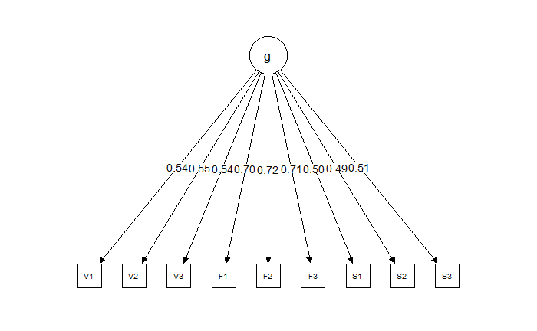
SIM Results (POT Algorithm)
Notes:
And for the POT data the results also supported our prediction. We can see that here in the one-factor model apparently there are some loadings off for verbal and spatial tasks, while in the higher-order model everything looks good. More interestingly, For the higher-order model, we can see that the factor loading of the fluid ability factor is stronger than the loadings of the verbal and spatial factors. This is also consistent with real-world findings.

Slide 31
Summary of Fit Indices
Means (Standard Deviations) for the Fit Indices from the Models Based on Simulated Data from 200 Iterations (by the Algorithm and the Model Structure)
 |  | χ² | CFI | RMSEA | SRMR | AIC
POT | Higher-Order | 26.21 (6.57) | 1.00 (< .01) | .01 (.01) | .02 (<.01) | 58565.72 (138.62)
 | One-Factor | 1637.46 (87.18) | .56 (.02) | .24 (.01) | .15 (.01) | 60170.97 (169.36)
GSM | Higher-Order | 26.77 (7.49) | .99 (< .01) | .01 (.01) | .01 (<.01) | 56411.03 (127.53)
 | One-Factor | 27.69 (7.65) | 1.00 (< .01) | .01 (.01) | .01 (<.01) | 56405.96 (127.42)
Notes:
I have also attached the summary of fit indices from the 200 iterations here with means and standard deviations.

Slide 32
Interpretation
For both POT and GSM algorithms, a positive manifold emerged from the simulated test scores in the absence of a general cognitive ability
Results from the POT algorithm is aligned with real-world observations:
The higher-order structure of cognitive abilities emerged from domain-general/specific specification of processes
The high loading of fluid subfactor on higher-order g in the POT model
Notes:
For the higher-order model of POT, the fluid ability subfactor has a stronger loading on the higher-order g factor compared to other broad-ability subfactors
In this study, we used simulation approaches based on sampling theories to demonstrate that a positive manifold could emerge even without a common source of variance. We also went a further step by using a POT sampling algorithm that accounts for cognitive mechanisms in the simulation and achieved results in psychometric models that are compatible with real-world findings such as the higher-order structure and the stronger g loading of fluid ability. This provides supportive evidence for POT as an alternative to g theories to investigate the positive manifold. It also exhibits how the POT framework could bridge traditional psychometric theories and cognitive theories.
Now in this study, if we remember, the simulated test scores based on cognitive algorithms were examined by latent factor models, and they were all reflective latent factor models. A latent factor is assumed to be the common cause of the variances in manifest variables. And that’s compatible with the traditional g theories that emphasized “general intelligence” as the key to everything.

Slide 33
POT Structural Model
Notes:
However, as we have said before, POT does not assume a psychological general intelligence and considers the g factor as a formative, statistical artifact, like this. In other words, in POT the g factor should be the outcome but not the resource of the common variance. So technically, a conventional higher-order model is not fully compatible with POT. Unfortunately there is no way to do a formative factor without an external outcome variable. But luckily, we have a more recent statistical approach that can represent the positive manifold in a way that is more compatible with POT. And it is the psychometric network approach.

Slide 34

A Psychometric Network of the POT Simulation
Apply a Psychometric Network to the Simulation (POT-N)
Extending the original simulation results by applying a network structure to the psychometric model of POT (POT-N)
Notes:
So we’d also like to extend the original simulation results by applying psychometric networks to the simulated data. The network approach is inspired by data methods such as social network analysis, where relationships among people are investigated through graph theory and networks. For a social network, people are represented by nodes, and their relationships are represented by edges. For a psychometric network, test measures are represented by nodes, and their relationships are represented by weighted edges where the weights indicate pairwise partial correlations, indicating the strength of the association of two nodes when controlling for all other variables. This network interpretation of POT is referred to as POT-N.

Slide 35
A Network Model of POT
Why POT-N?
An alternative representation to the positive manifold
Shifts the main emphasis from a common cause to the direct mutual associations among specific cognitive measures
The struggle is real
Notes:
I believe that the POT-N would be a better alternative representation to the positive manifold based on POT perspective and the network models would shift the main emphasis of intelligence theories from a common cause to the direct mutual associations of different cognitive measures, which reflect different underlying cognitive processes.

Slide 36
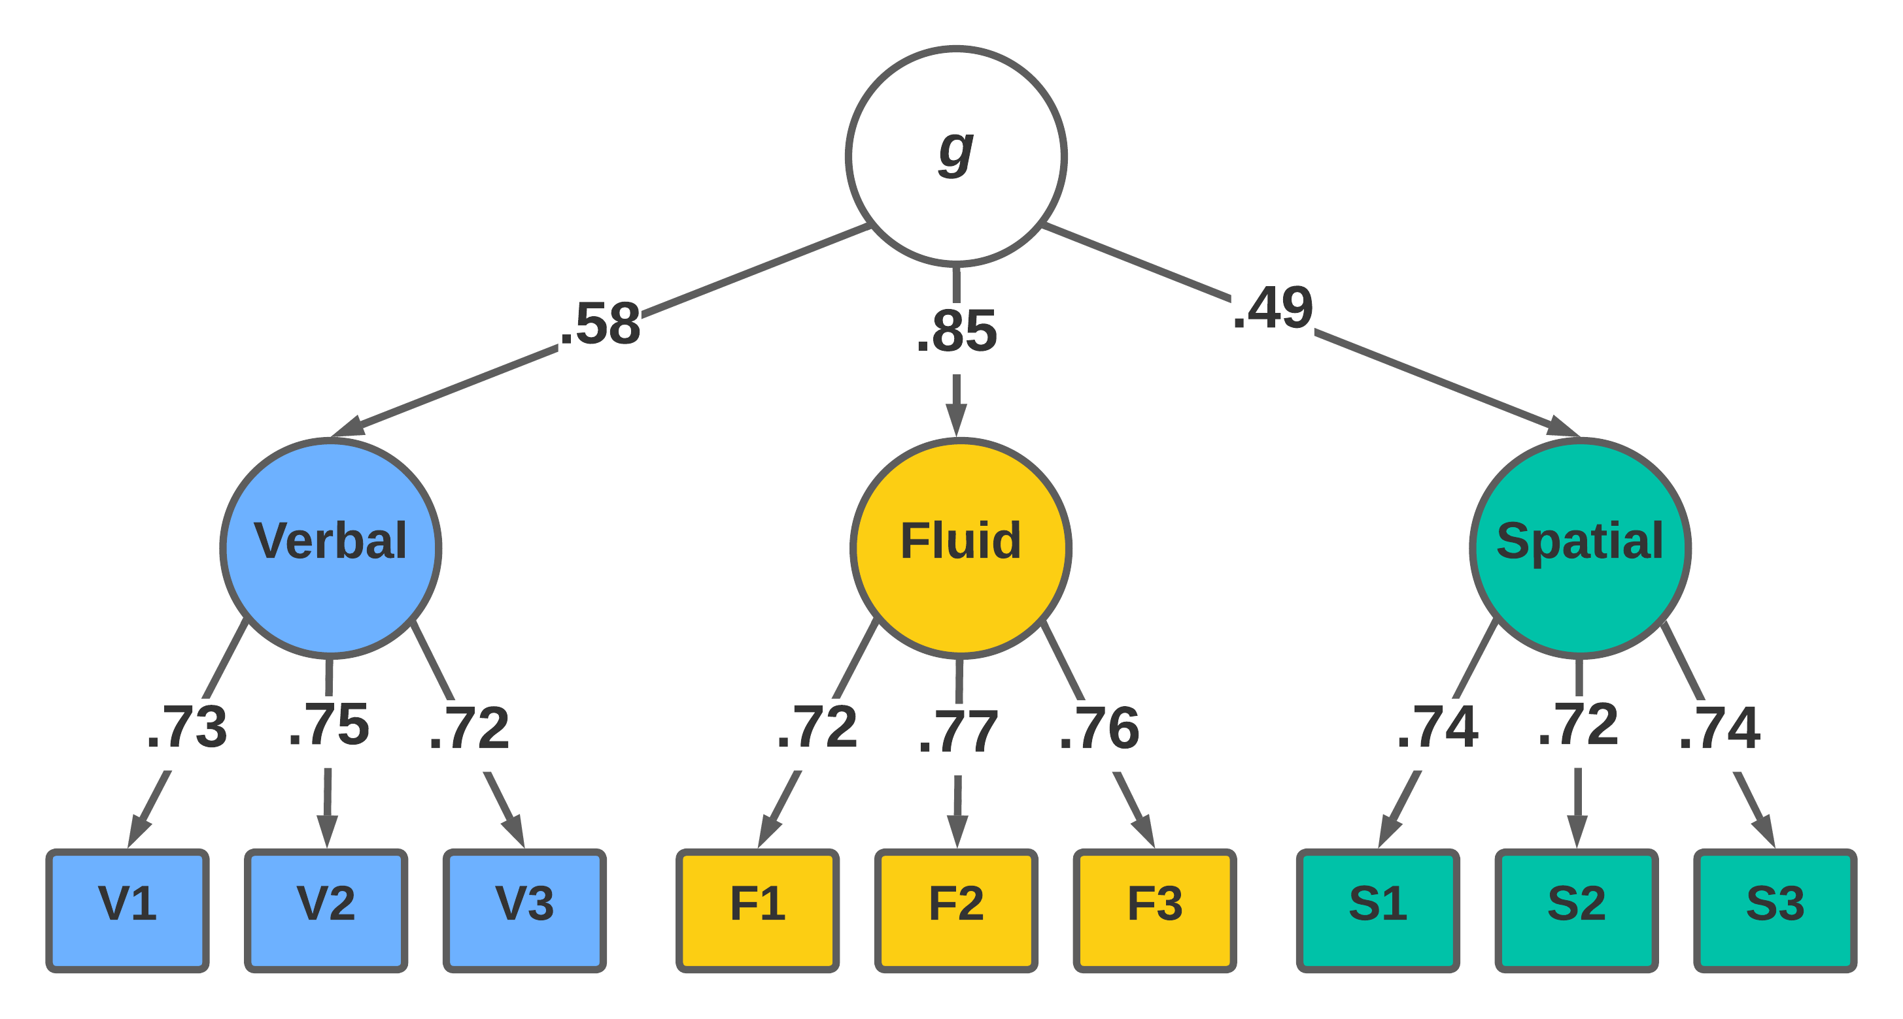
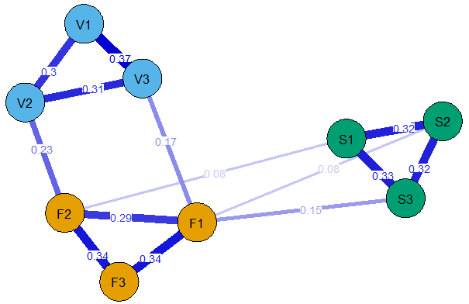
Network Results
Offers an alternative perspective to investigate the correlational structure of individual differences in cognitive abilities without a common cause assumption
Notes:
In the network model, nodes represent the manifest variables which are the simulated scores from 9 tests. Edges represent partial correlations between pairs of the manifest variables and the width of these edges represent the magnitude of the partial correlation. The network model was optimized so that the edges that were either not significant or too weak were excluded. We can see that the standard network actually described the same correlations among the 9 simulated manifests without assuming any latent factor. The three broad abilities were represented by the three clusters of nodes, and comparing to the verbal and spatial tests, the fluid tests played a more central role in the network model.

Slide 37
Takeaways
The simulation algorithm illustrated a cognitive mechanism based on POT and reflected it in psychometric models
These results demonstrated that the positive manifold and a higher-order structure can be achieved without a general cognitive process as the common cause
The network model proposed an alternative perspective of psychometric interpretations of individual differences in cognitive abilities based on POT
Say more about experiential approach, WM and EF
Notes:
Started from translating the theoretical model of POT into a simulation with latent factor models, and extended the simulation by applying network models to the data because they are more compatible with the process overlap theory and combines psychometric and cognitive perspectives in a better way.
This simulation approach provides supportive evidence for POT and illustrates an alternative theoretical and statistical framework for contemporary research of human cognition that attempts to combine the psychometric and cognitive theories of cognitive abilities.

Slide 38
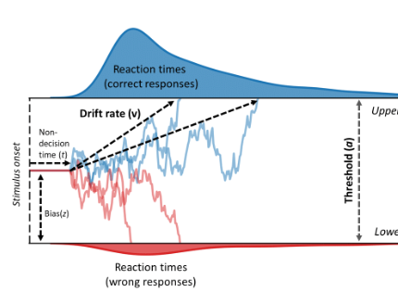
Moving Forward...
For the simulation algorithm:
Improving the sampling algorithm of POT
Incorporating drift-diffusion model to account for reaction time measures
Assumption tests based on algorithms and parameters
Notes:
In the current sampling mechanism, the “cognitive processes” are only random numbers that are conceptually equivalent. The cognitive distinctions are specified only by the sampling mechanism such as the sampling probabilities. This could be updated by introducing different types of cognitive processes in the simulation that could account for more behavioral and neural science observations, such as simulated cognitive processes/mechanisms that could reflect processing speed based on reaction time measures.

Slide 39
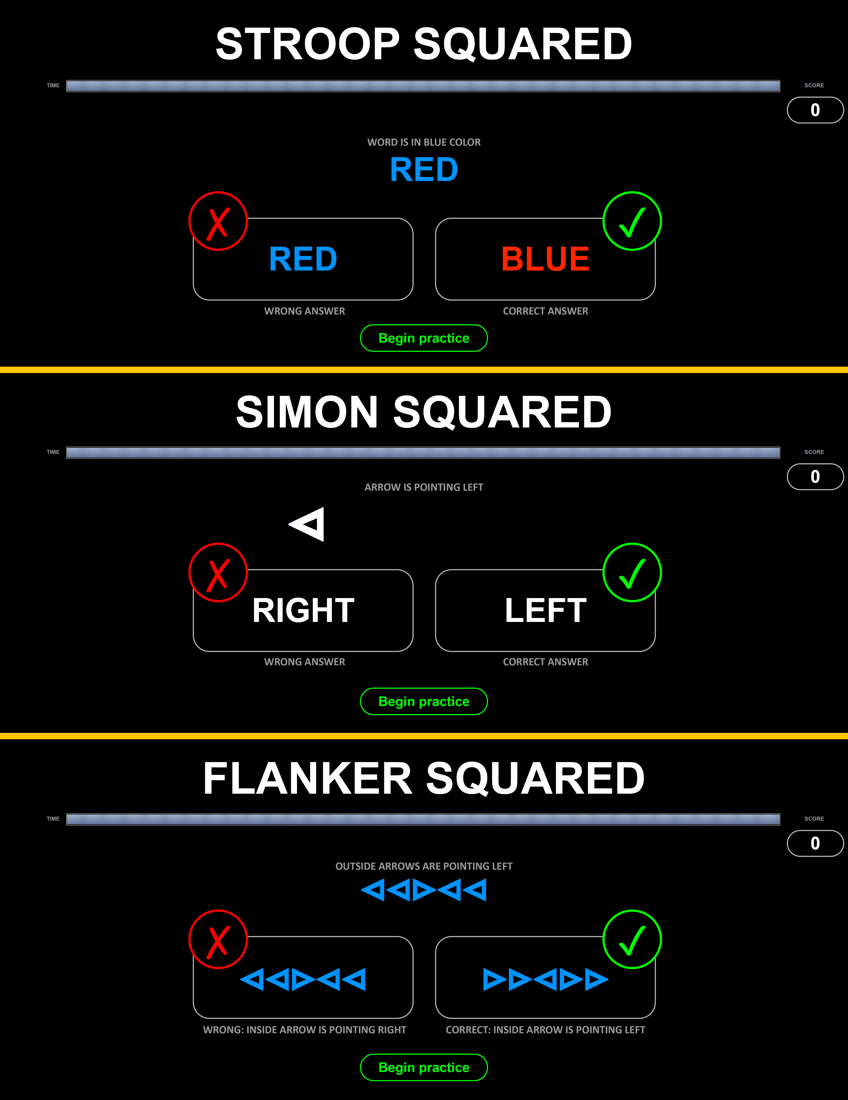
Moving Forward...
For the experimental approach:
Deconstructing the latent construct of attention control measured by the Squared Tasks (Burgoyne et al., 2023)
A “square root project”

Slide 40
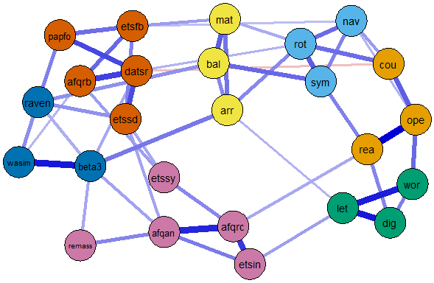
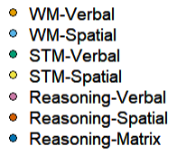
Moving Forward...
For the psychometrical approach:
Network Modeling on Empirical data of cognitive abilities
Working memory & Reasoning (Kane et al., 2004)
Notes:
For the network modeling aspect, given the exploratory nature of network psychometrics, it is important to apply this approach to a variety of samples of cognitive tests and subjects before we reach a generalizable interpretation of POT. Network psychometrics is also developing rapidly and recent techniques encourage more confirmatory analyses using network models such as multi-group invariance comparison, time-series modeling, or even meta-network analysis

Slide 41
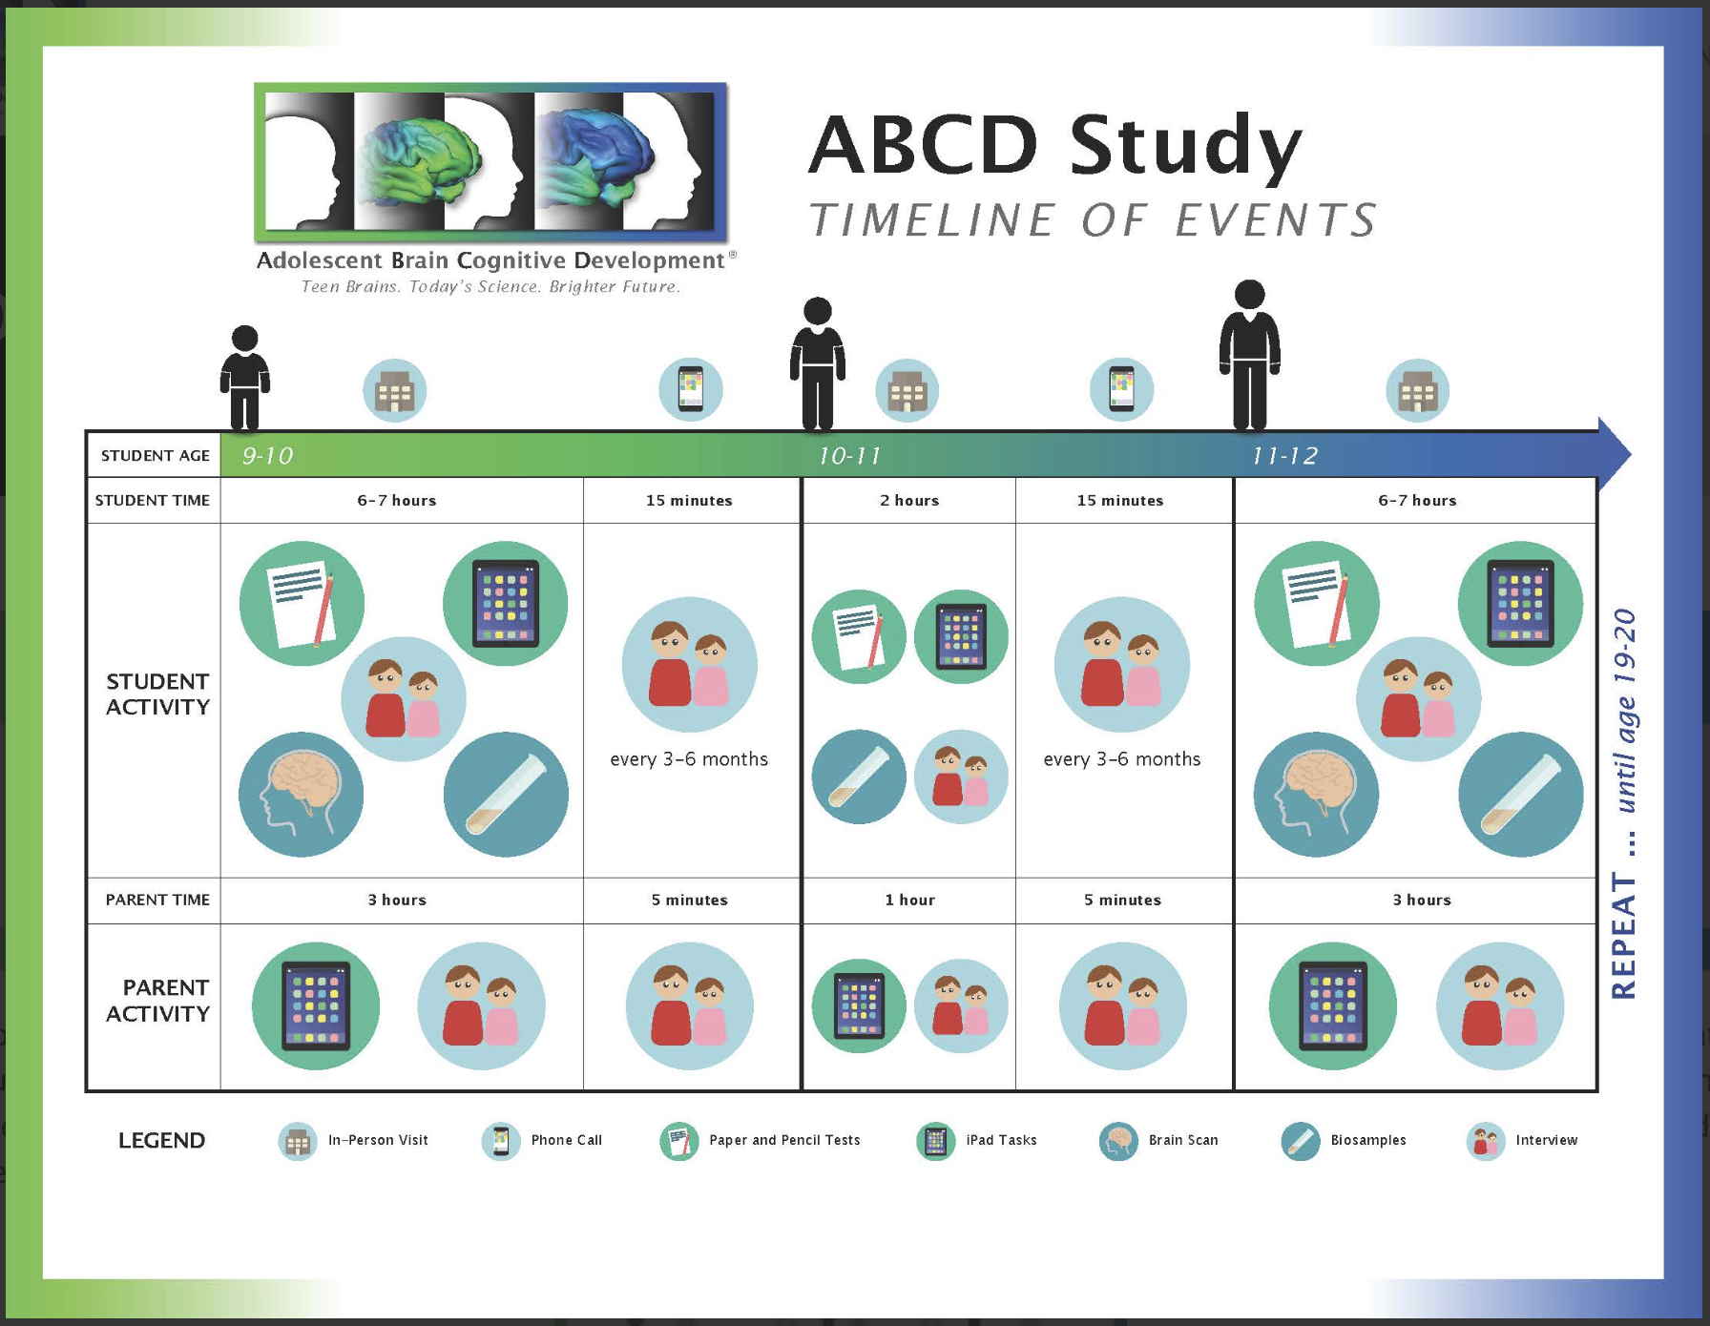
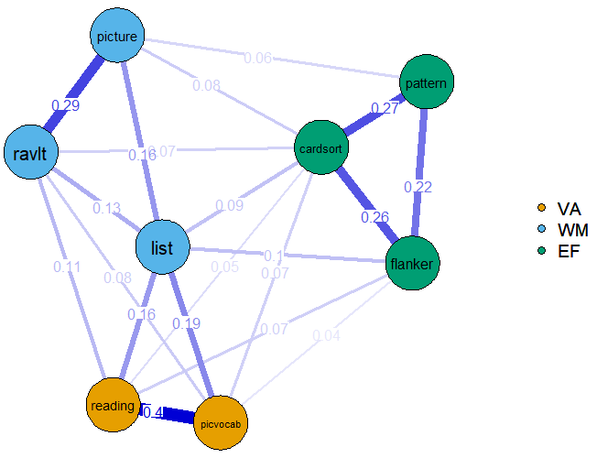
Moving Forward...
For a longitudinal approach:
The Adolescent Brain Cognitive Development (ABCD) Study
Network inspection on adolescents’ cognitive development

Slide 42
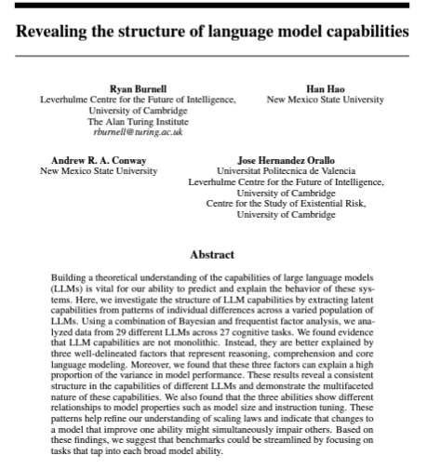
Moving Forward...
A machine cognition approach:
The understanding of Cognitive abilities of AI could help the understanding of human cognition
Psychometrics
Cognitive behaviors (ToM)

Slide 43

THANK YOU
Han Hao
hanhao@nsmu.edu
Hanhao23.github.io

Slide 44




SUMMARY
With PowerPoint, you can create presentations and share your work with others, wherever they are. Type the text you want here to get started. You can also add images, art, and videos on this template. Save to OneDrive and access your presentations from your computer, tablet, or phone.

Slide 45


AGENDA
Topic one
Topic two
Topic three
Topic four

Slide 46
Sim Procedure – 1/4
Step 1: Specify the cognitive processes and tests
Simulate a sample of 1000 subjects performing 9 tests, each has 100 items
3 fluid reasoning tests, 3 verbal tests, 3 spatial tests
Each subject has a set of 60 cognitive processes
15 Executive Function (EF) Processes
15 Fluid Reasoning Processes, 15 Verbal Processes, and 15 Spatial Processes
Each individual subject has an ability level on each process (orthogonal and normally distributed)
A 1000 x 60 Matrix

Slide 47
Sim Procedure – 2/4
Step 2: Apply 2 specific sampling algorithms to the simulated processes (POT and GSM)
The general sampling algorithm (GSM):
All 60 processes are sampled with equal probability (p = .10) across every task and item
For a specific item, about 60*0.10 = 6 processes are expected to be sampled
Notes:
two algorithms are developed and compared

Slide 48
Sim Procedure – 2/4 (continued)
Step 2: Apply 2 specific sampling algorithms to the simulated processes (POT and GSM)
The POT algorithm:
For an item in Gf tests, domain-general (EF) processes are sampled with greater probability (p = .28) than domain-specific (Fluid Reasoning) processes (p = .12)
On average, 4 EF (15*0.28) + 2 Fluid (15*0.12) processes are expected to be sampled for an item
For an item in verbal/spatial tests, domain-general (EF) processes are sampled with smaller probability (p = .12) than domain-specific (Verbal/Spatial) processes (p = .28)
On average, 2 EF (15*0.28) + 4 specific (15*0.12) processes are expected to be sampled for an item

Slide 49
Sim Procedure – 3/4
Step 3: Calculate item scores from the 2 algorithms
The GSM Algorithm:
all sampled processes are summed and standardized to calculated the corresponding “latent trait” required for an item
The POT Algorithm:
the processes within a domain are summed and standardized as the dimensional “latent trait”
The “Latent traits” are converted to probabilities by IRT functions (logistic functions) and are used to generate binary responses of items (0s and 1s)
1000 (subjects) × 9 (tests) × 100 (items)
Notes:
Two 3-D arrays of binary values: 1000 (subjects) × 9 (tests) × 100 (items)
“1PL” for the IRT functions of simulated items, a = 1, b ~ N(0, I)

Slide 50
Sim Procedures – 4/4
Step 4: Fit psychometric models to simulated data
GSM – The One-Factor Model
POT data – The Higher-Order Model
Notes:
We predict that for the GSM data the one-factor model would fit well, and the higher-order model would be an overfit.
For the POT data the one-factor model should convey poor fit while the higher-order model would be appropriate.

Slide 51
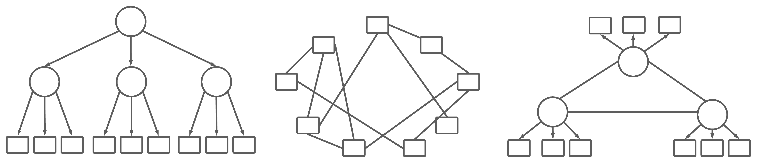
Psychometric Network
Three types of models on a simulated dataset of POT algorithm
Latent factor model (higher-order)
Psychometric network of the 9 tests (standard network model)
Latent network model of the 3 types of tests (latent factors + network)
Notes:
Specifically, in study 2 we fitted three types of statistical models on one simulated dataset based on the POT algorithm, which we have just gone through in Study 1. The three models will be a latent factor model, same as it was in study 1; a psychometric network model, which is an exploratory graphic network model that estimates the partial correlation associations among manifest variables; and a latent network model, which is a mixture of exploratory and confirmatory models and combines the benefits of the previous two types of models. We think that the latter two network models are more compatible with POT.

Slide 52
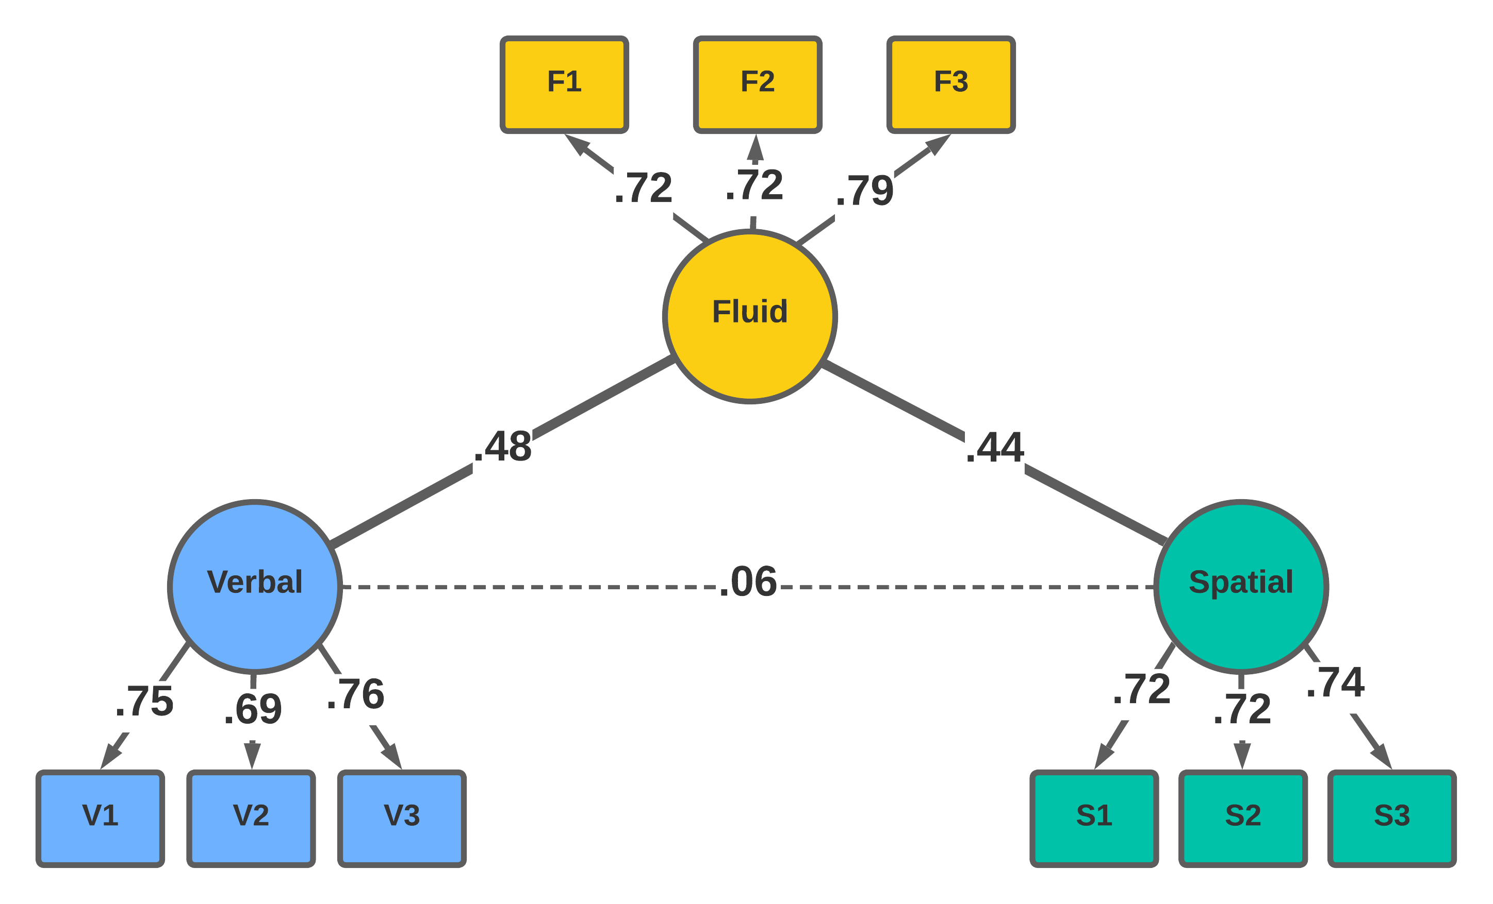
Results - Latent Network
Notes:
Now in this result we can also see that the benefits of latent factor model and network model were combined in the latent network model.

Slide 53
Comparing the Latent Constructs
Latent Factor Model: Latent factor scores for the sub-factors
Standard Network Model: “Cluster scores” for the clusters of nodes
Latent Network Model: Latent factor scores for the latent nodes

Slide 54
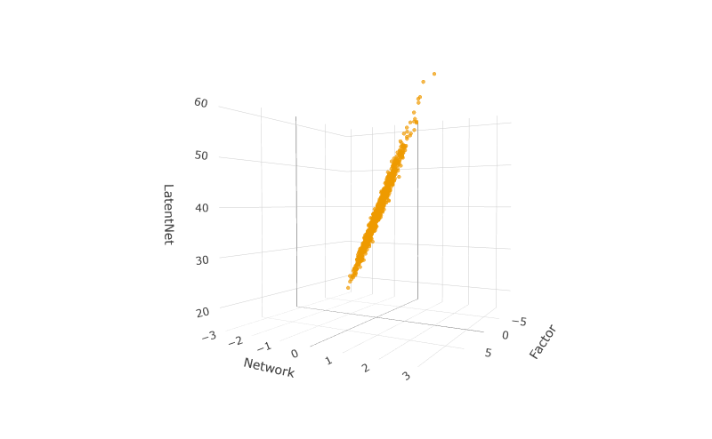
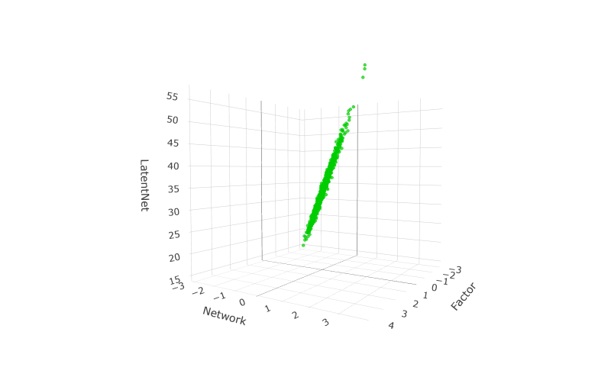
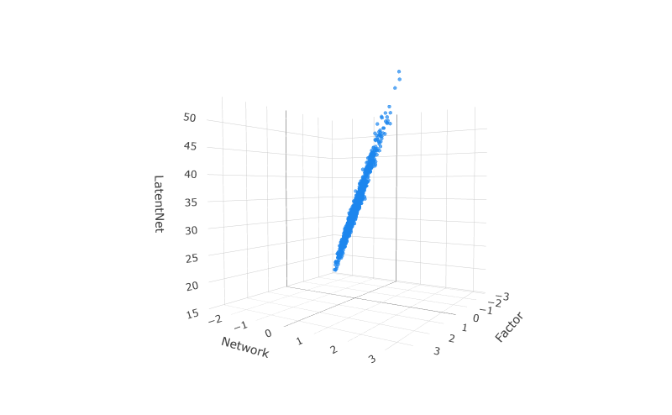
Results – Factor/Cluster Scores
Fluid Spatial Verbal

Slide 55
Results – Factor/Cluster Scores

Slide 56
Cognitive theories
Executive functions (Diamond, 2013; Frischkorn et al., 2019)
correlated with intelligence, but evidence is mixed
Notes:
Cognitive theorists have already identified several essential cognitive processes of intelligence. Three of the most frequently discussed cognitive processes/mechanisms are processing speed, working memory, and executive functions. And it is commonly agreed that these three mechanisms are all important predictors of individual differences in intelligence. Unfortunately, there is still limited consensus on their exact roles and relationships to intelligence and between each other.

